Slide 1

SQL Keywords:
INSERT, UPDATE, DELETE, SELECT

Slide 2
A tiny bit of SQL background
Stands for Structured Query Language
Used with Relational Database Management Systems
Lots of different SQL clients and systems:
MySQL
Microsoft SQL Server
Oracle
Cloud Systems like Google Cloud, AWS (Amazon), Snowflake, etc.

Slide 3

Is it pronounced “S-Q-L” or “Sequel?”

Slide 4
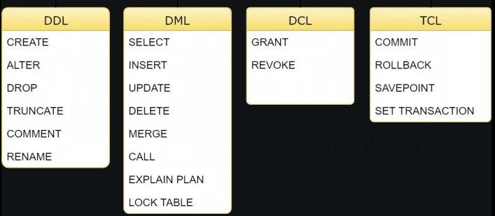
Types of SQL Keywords
Consensus is 4 Groups of SQL commands
Some think DML should be split

Slide 5
INSERT (INTO)
The INSERT statement allows you to….. Insert data into a table
Used in its own statement
Must have the full phrase INSERT INTO followed by VALUES;
Must end in a semicolon ;
Values are listed in same order as columns (fields)
INSERT INTO table_name (column1, column2, etc)
VALUES (value1, value2, etc);
INSERT INTO students (studentID, firstname, lastname)
VALUES (0001, ‘Fred’, ‘Flintstone’),
(0002, ‘Donald’, ‘Duck’);

Slide 6
UPDATE (SET)
UPDATE table_name
SET column1 = value1, column2 = value2
WHERE condition;
UPDATE students
SET firstname = ‘George’, lastname = ‘Jungle’
WHERE studentID = 0005;
UPDATE is used to change existing values in a table
Indicates specific columns that need to be changed to certain values
Used with the SET and WHERE clauses
MUST HAVE A WHERE CLAUSE
Every value in the table will be changed without a WHERE clause to indicate which records are being updated

Slide 7
DELETE (FROM)
DELETE is used to delete records from a table
It is not used to delete tables (DROP is used for that)
Will delete entire row (record)
Always used as DELETE FROM
MUST HAVE A WHERE CLAUSE
Every value in the table will be deleted without a WHERE clause
DELETE FROM table_name
WHERE condition;
DELETE FROM students
WHERE firstname = ‘Fred’;
(WHERE studentID = ‘0001’) is better!

Slide 8
SELECT
SELECT is used to select data from a database
May include column names, certain keywords, string methods and more
Must include a FROM clause at a minimum to specify where the data is coming from
Using SELECT * will include all columns
SELECT column1, column2, column4
FROM students;
SELECT *
FROM students;
SELECT firstname, lastname
FROM students;

Slide 9
Some Keywords for SELECT clause
DISTINCT – SELECT DISTINCT will filter duplicates
MIN(column_name) – Selects lowest value in column
MAX(column_name) – Selects highest value in column
COUNT(column_name) – Provides a count of values in the column (as specified in a different clause)
AVG(column_name) – Provides the average value in that column
SUM(column_name) – Adds all values in the column together

Slide 10
Uses in Web Development
Vital for any kind of financial transaction
Needed to store user information
Servers host web content, and Relational Databases are used to store a lot of that info
SELECT statements always required to retrieve data
INSERT, UPDATE, DELETE used very frequently to update sales transactions, user information, inventory, etc.

